Slide 1

Version Control and GitHub
GitHub Workshop
Cassandra Hui, Ph.D.
25 March 2025

Slide 2
Outline
Version Control
Git and GitHub
What is Cloning
Collaboration
Branching
GitHub Pages: Making your own website

Slide 3
Version Control
A system that records your files over time.
Collaboration: Multiple people can work on the same project simultaneously without overwriting each other’s work.
History Tracking: Keeps a record of changes, so you can revert to earlier versions if something goes wrong.
Example: “Track changes” in Microsoft Word and “Undo” feature in any software.

Slide 4
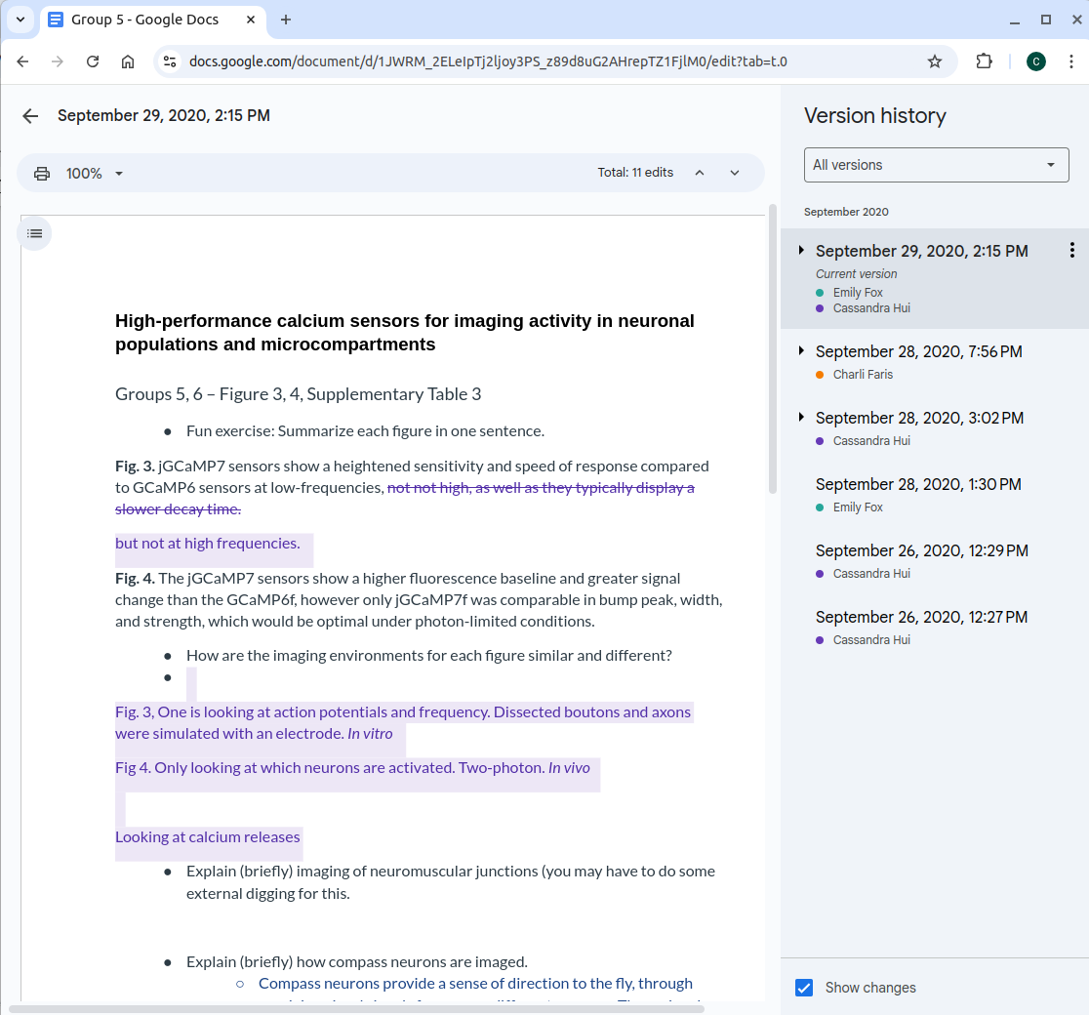
Version Control
Example: Google Docs

Slide 5

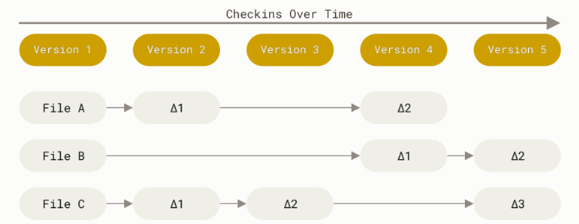
Git
Git is a version control
It tracks changes to files and allows collaboration
Allows you to work offline and sync changes later
Commits create “snapshots” of the entire project, not just the differences
Can be stored in a remote location

Slide 6
Git
Git is a version control
It tracks changes to files and allows collaboration
Allows you to work offline and sync changes later
Commits create “snapshots” of the entire project, not just the differences
Can be stored in a remote location

Slide 7
Git
Git is a version control
It tracks changes to files and allows collaboration
Allows you to work offline and sync changes later
Commits create “snapshots” of the entire project, not just the differences
Can be stored in a remote location

Slide 8
Git
Git is a version control
It tracks changes to files and allows collaboration
Allows you to work offline and sync changes later
Commits create “snapshots” of the entire project, not just the differences
Can be stored in a remote location

Slide 9
Git
Git is a version control
It tracks changes to files and allows collaboration
Allows you to work offline and sync changes later
Commits create “snapshots” of the entire project, not just the differences
Can be stored in a remote location

Slide 10
Git
Git is a version control
It tracks changes to files and allows collaboration
Allows you to work offline and sync changes later
Commits create “snapshots” of the entire project, not just the differences
Can be stored in a remote location

Slide 11
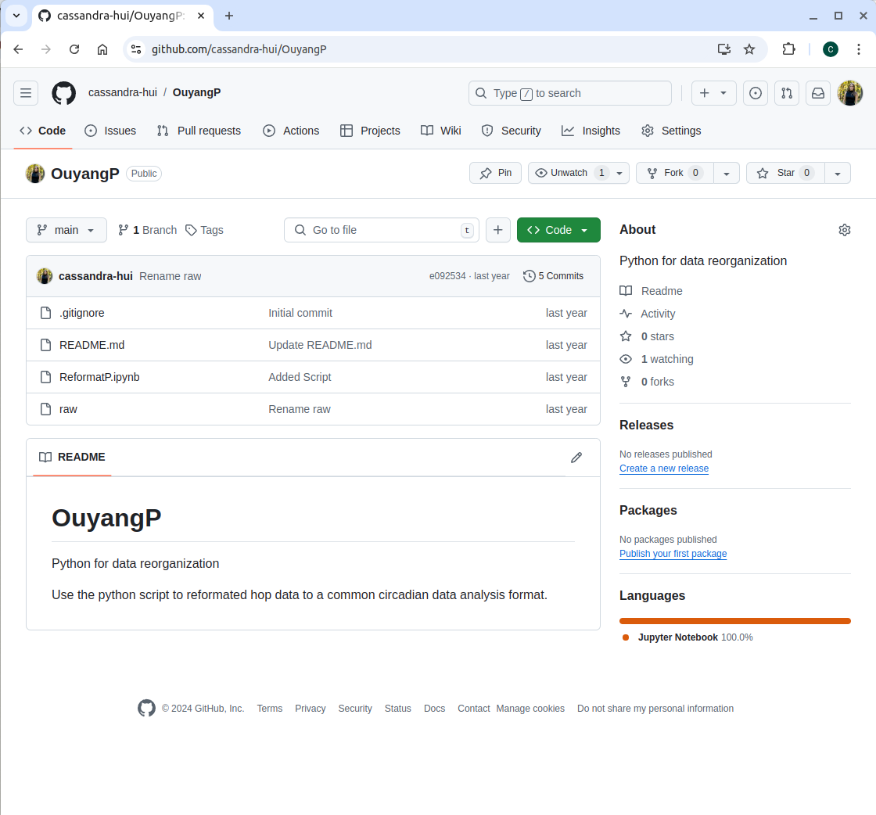
GitHub
User/Repository
Platform for hosting Git
Online (Remote) and free
Collaboration
Find other repositories (Course Materials)
Personal Portfolio
Files

Slide 12
GitHub

Slide 13
GitHub Definitions
Repository: A file of files
Clone: Create an exact copy of your repository on your local computer
Pull: Pulls new content from a remote repository
Push: Pushes new content from your local computer to a remote
Branching: Duplicates an exact copy a repository in the same repository and allows you to make changes without altering the main
GitHub Pages: A static site hosting service (website)

Slide 14
What is a repository?
A file of files
Location where items are stored
This can be on:
Your personal computer
Remote location
Both

Slide 15
Setting up a Repository
Visibility Options:
Public: Anyone can see your repository.
Private: Only you and collaborators can access the repository.
Initialize: Initializing a repository means setting up a new project folder (repository) for Git to start tracking changes. You can do this on your local computer or when setting up your repository online by adding selected files:
Add a README: Automatically adds a README.md file to get started.
Add a .gitignore File: GitHub provides templates for common languages and tools (e.g., Python, Node.js).
Add a License: GitHub lets you select and add a license when creating a repository.

Slide 16
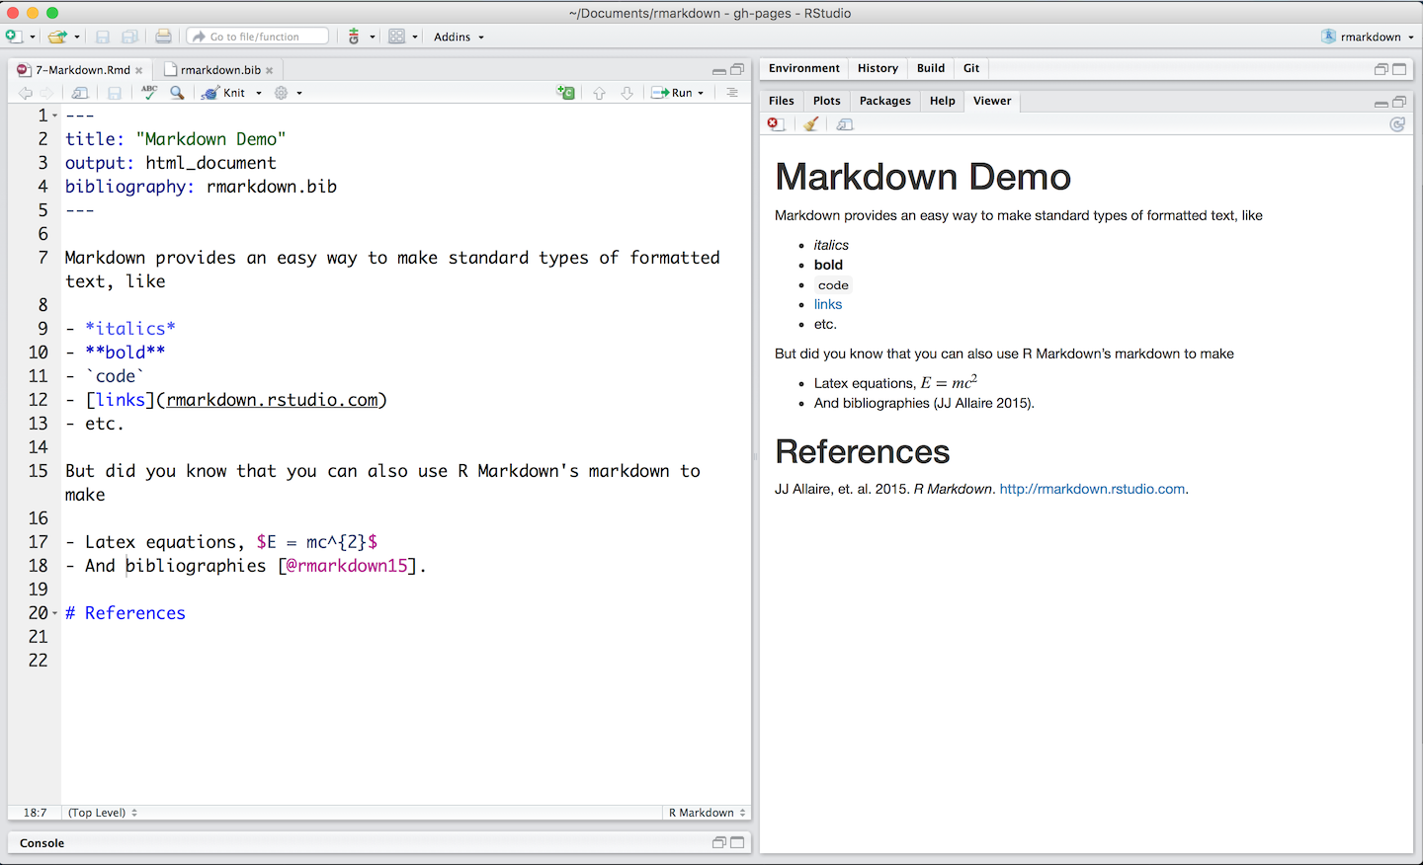
GitHub
README.md
Purpose: Provides a description of the repository and its purpose.
Why It’s Important: Helps others (and you!) understand what the project is about and how to use it.
What to Include:
Project title and description.
Installation instructions.
Usage examples.
Contact information or links.

Slide 17
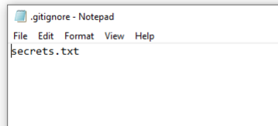
GitHub
.gitignore
Purpose: Specifies files or file types that Git should ignore (not track).
Why It’s Important: Prevents unnecessary or sensitive files (e.g., passwords, logs, system files) from being included in your repository.
Examples of Files to Ignore:
Temporary files (e.g., .DS_Store, *.tmp).
Files with sensitive information (e.g., personal files).

Slide 18
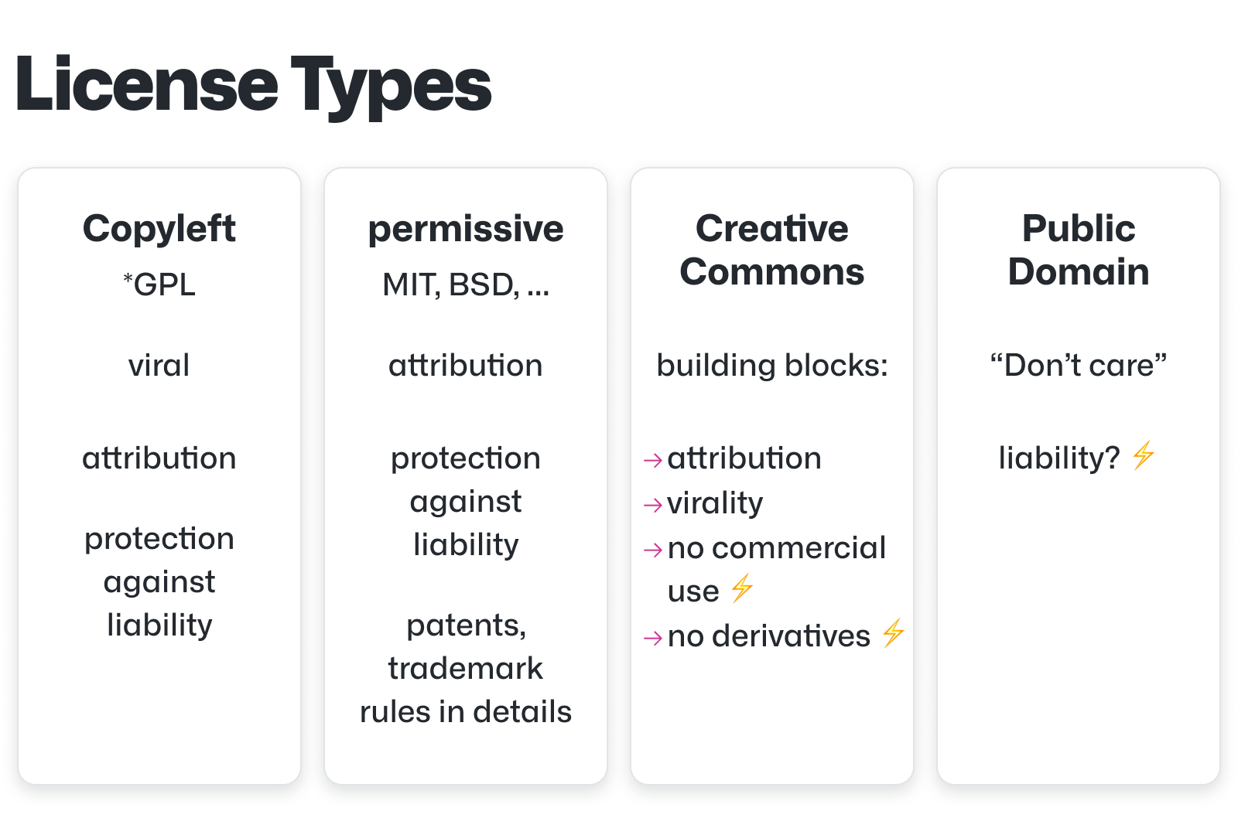
GitHub
LICENSE
Purpose: Specifies how others can use your code.
Why It’s Important: Protects your work and clarifies usage rights.

Slide 19
Text Editor
What is a Text Editor?
A text editor is a tool for writing and editing plain text files, essential for coding.
Unlike word processors, text editors don’t add formatting, making them ideal for programming.
Why do we need a text editor? Allows you to write, modify, and save source code files (e.g., .md, .R, .html).

Slide 20
Hands-ON: Create a GitHub Repository
Test Repository
Follow 1_setup.md in the Practice folder
Create repository
Add a file
Update README.md

Slide 21
Create a Repository

Slide 22
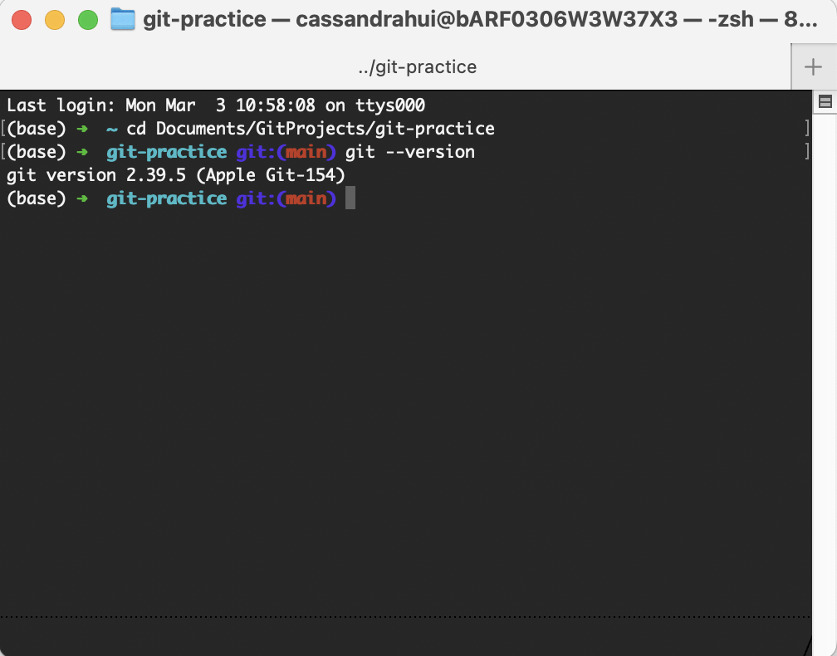
Git as a Version Control
Git is a version control system you can use from your terminal or command prompt.
We’ll cover the basics: initializing a repo, tracking changes, committing, and pushing to GitHub.

Slide 23
Git Workflow on a Local Machine
Initiate a Repository
Edit files
Add files to the staging area
Commit changes

Slide 24
Git Workflow
You have files you want to put into a version control system
git init

Slide 25
Git Workflow
You have files you want to put into a version control system
git init
edit files

Slide 26
Git Workflow
You have files you want to put into a version control system
git init
edit files
Staging Area
git add
Add everything to the staging area you want to track

Slide 27
Git Workflow
Repository
HEAD
You have files you want to put into a version control system
git commit
git init
edit files
Commit your changes with a commit message (meta-data)
Staging Area
git add
Add everything to the staging area you want to track

Slide 28
Git Workflow
Commit object
Commit object
Commit object
Repository
HEAD
HEAD ~1
HEAD ~2
HEAD ~3
You have files you want to put into a version control system
git commit
git init
edit files
Commit your changes with a commit message (meta-data)
Staging Area
git add
Add everything to the staging area you want to track

Slide 29
GIT ON THE COMMAND LINE

Slide 30
What is Cloning?
Create an exact copy of your repository on your local computer
This can be done:
On the command line
With GitHub Desktop
You can work from your local computer and update your repository:
Push to move new work to a remote location
Pull to bring new work to your local computer

Slide 31



Remote Location
Emily's Computer
Remote
Project
Raw Data
Stats.R
README.md

Slide 32
Remote Location
Emily's Computer
Remote
Project
Raw Data
Stats.R
README.md
Commit

Slide 33
Remote Location
Emily's Computer
Remote
Project
Raw Data
Stats.R
README.md
Clone

Slide 34
Remote Location
Emily's Computer
Remote
Editing stats script
Writing manuscript
Project
Raw Data
Stats.R
README.md
Clone

Slide 35
Remote Location
Emily's Computer
Remote
Project
Raw Data
Stats.R (v2)
Commit
Push
README.md
Clone
Manuscript

Slide 36
Remote Location
Emily's Computer
Remote
Project
More work
Raw Data
Stats.R (v2)
Push
README.md
Clone
Manuscript

Slide 37
Text Editor
Why We Will Use Visual Studio Code?
Visual Studio Code (VS Code) is one of the most popular text editors for developers. Here’s why we recommend it:
Free and Cross-Platform:
Available for Windows, macOS, and Linux and completely free.
Beginner-Friendly:
Easy to install and set up.
Shows folders and makes it easy to add any type of file.
3. Powerful Features:
Syntax Highlighting and Autocomplete:
Highlights code based on the programming language and built in code completions.
Built-In Git Integration

Slide 38

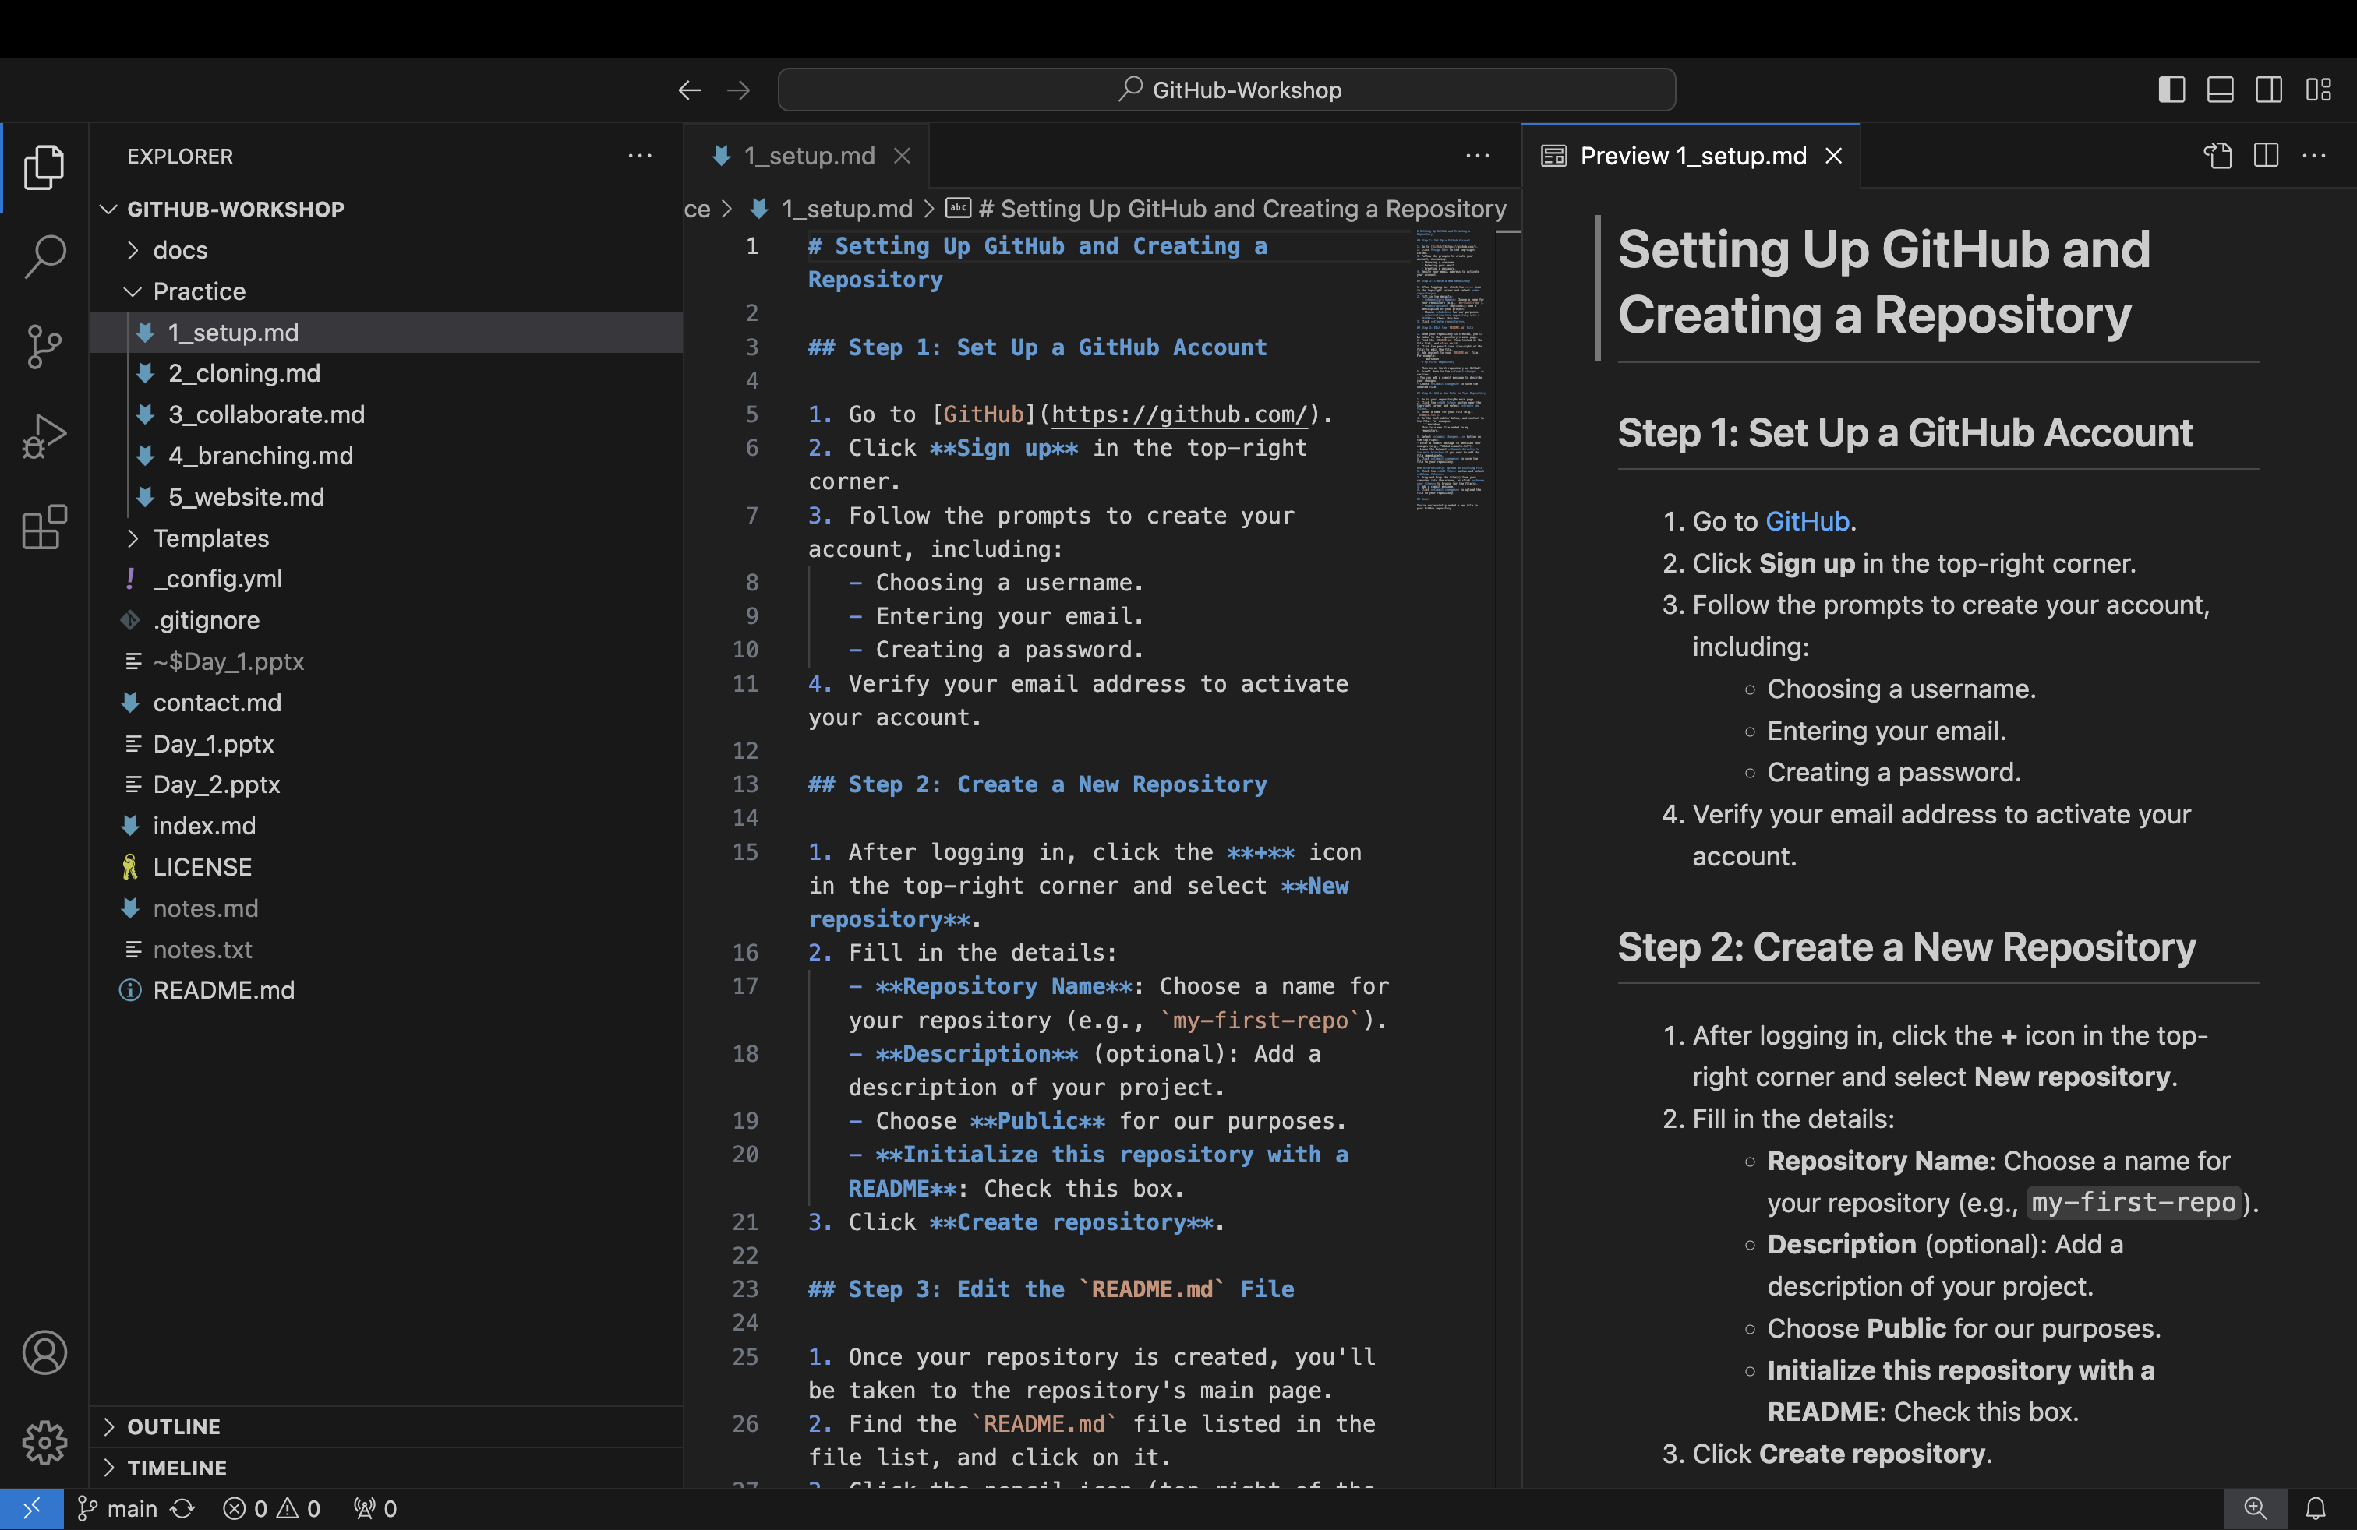
Text Editor

Slide 39
Hands-On: Cloning
Working on your local computer
Download VS Code
Follow 3_cloning.md in the Practice folder
Download GitHub Desktop
Clone your repository
Edit/add files
Push

Slide 40
Clone a Repository

Slide 41
Collaboration
Work Together Easily: GitHub allows multiple people to work on the same project simultaneously by syncing changes through repositories.

Slide 42
Remote Location – Collaboration
Emily's Computer
Remote

Slide 43
Remote Location – Collaboration
Emily's Computer
Remote
Commit

Slide 44
Remote Location – Collaboration
Emily's Computer
Remote
Clone

Slide 45

Remote Location – Collaboration
Emily's Computer
Remote
Bob's Computer
Clone

Slide 46
Remote Location – Collaboration
Emily's Computer
Remote
Bob's Computer
Clone
Clone

Slide 47
Remote Location – Collaboration
Emily's Computer
Remote
Bob's Computer
Clone
Clone

Slide 48
Remote Location – Collaboration
Emily's Computer
Remote
Bob's Computer
Push
Commit
Clone
Clone

Slide 49
Remote Location – Collaboration
Emily's Computer
Remote
Bob's Computer
Pull
Push
Clone
Clone

Slide 50
Remote Location – Collaboration
Emily's Computer
Remote
Bob's Computer
Pull
Push
Clone
Clone

Slide 51
Remote Location – Collaboration
Emily's Computer
Remote
Bob's Computer
Push
Pull
Push
Clone
Clone

Slide 52
Remote Location – Collaboration
Emily's Computer
Remote
Bob's Computer
Pull
Push
Updated Project
Pull
Push
Clone
Clone

Slide 53
Remote Location – Collaboration
Emily's Computer
Remote
Bob's Computer
More work
Pull
Push
Pull
Push
Clone
Clone

Slide 54
Collaboration
Share and Work Together: GitHub makes it easy to collaborate by allowing multiple people to work on the same project at the same time, sharing changes through repositories.
Syncing is Key: Always pull the latest changes from the repository before you start working to ensure you’re up to date with your team’s progress.
Track and Communicate Changes: Use clear commit messages to describe your updates so everyone understands what’s been changed and why.

Slide 55
Cloning Other Repositories
Cloning creates a local copy of a repository on your computer, allowing you to view, edit, and work with the files offline without affecting the original repository.

Slide 56
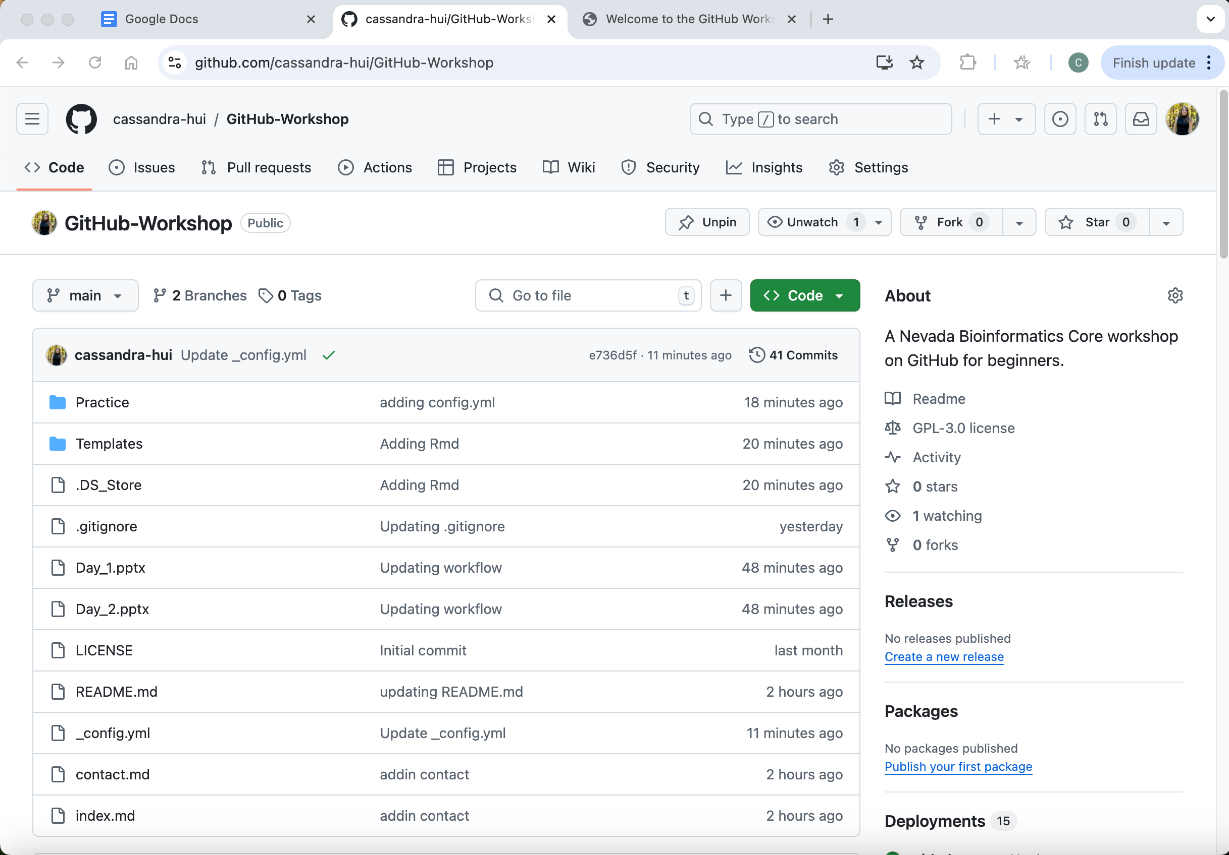
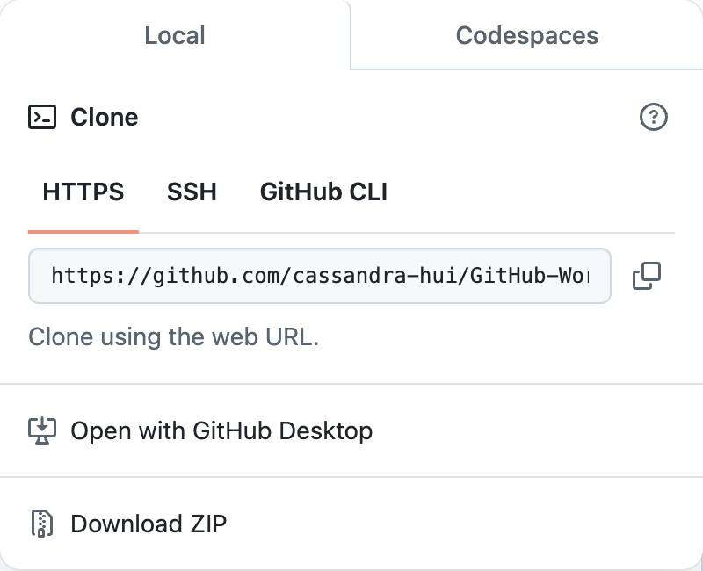

Slide 57
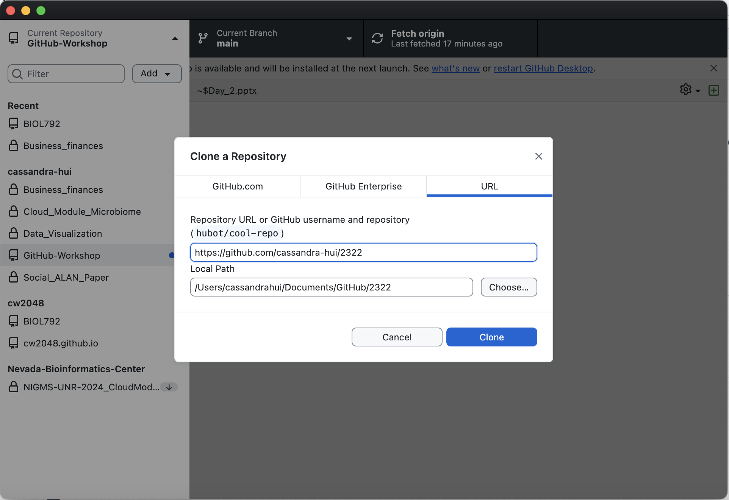

Slide 58
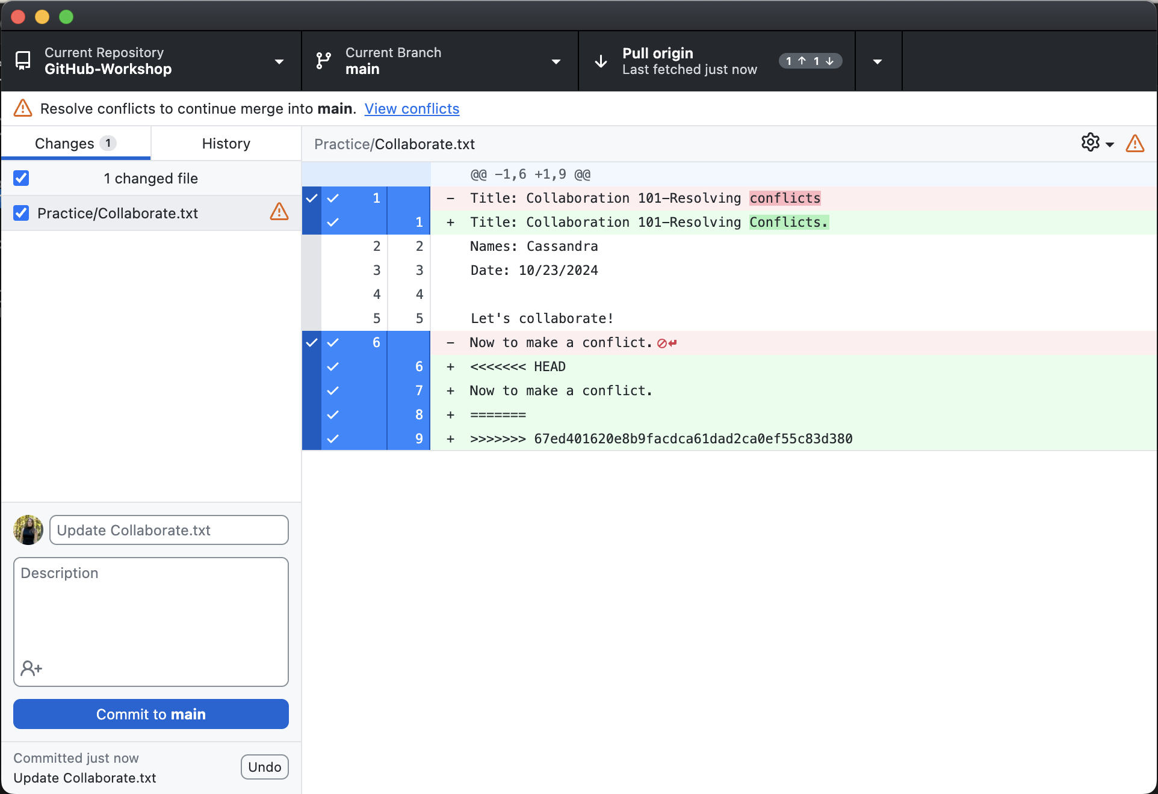
Resolving Conflicts
What Are Conflicts?
Conflicts happen when two people make changes to the same part of a file in a repository and Git cannot automatically decide which change to keep.
How to Resolve Conflicts?
Git shows you the conflicting sections, and you decide how to combine the changes.
Conflicts are resolved locally (on your computer) or online (on GitHub, using the conflict editor).

Slide 59
Collaborate
Follow the 4_collaborate.md file in the Practice folder
Add a collaborator to your repository
Make conflicting edits
Resolve conflicts

Slide 60
Collaborate

Slide 61

BRANCHING
What is Branching?
Branching is a way to create a separate version of your project within the same repository.
It allows you to work on new features, fix bugs, or experiment without affecting the main (production) version of your code.
The main branch (sometimes called master) is the default branch created and is typically the stable version of the project.

Slide 62
Why Use Branching?
Keeps the main branch stable and clean while allowing for parallel development.
Enables collaboration by allowing multiple team members to work on different branches simultaneously.
Helps avoid conflicts by isolating changes in dedicated branches.

Slide 63
How to Use Branching
• When you create a branch, Git duplicates the current state of the repository into the new branch.
• You can switch between branches to work on different versions of the project.
• Once the changes in a branch are complete, you can merge them back into the main branch.

Slide 64
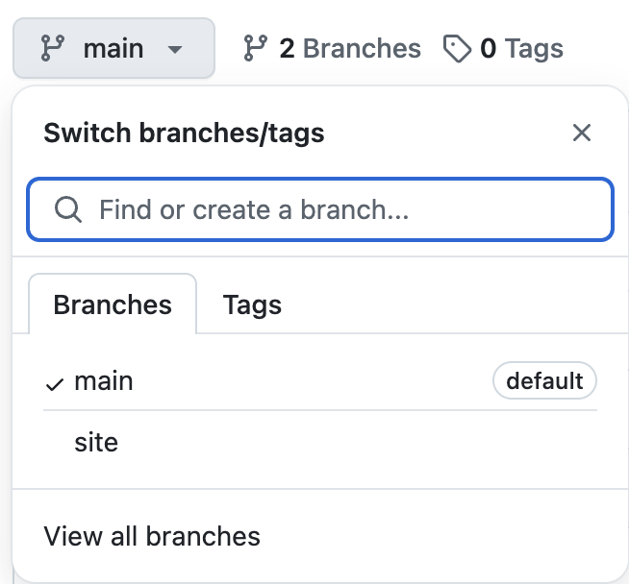
Workflow
Create a branch: Create a new branch for each feature, bug fix, or experiment.
Make changes: Work on the new branch without impacting the main branch.
Merge the branch: Once your changes are complete and tested, merge the branch into the main branch.
Delete the branch: After merging, you can delete the branch to keep your repository clean.

Slide 65
Branching
Follow the 5_branching.md file in the Practice folder
Create a branch and make edits
Create a pull request and merge with the main
Delete a branch

Slide 66
Create a Branch

Slide 67
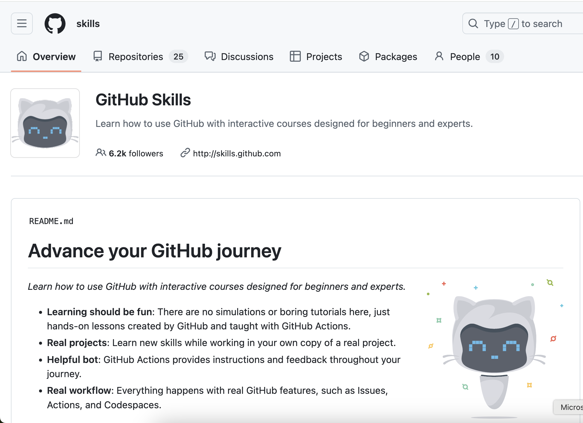
Learn More
https://github.com/skills

Slide 68
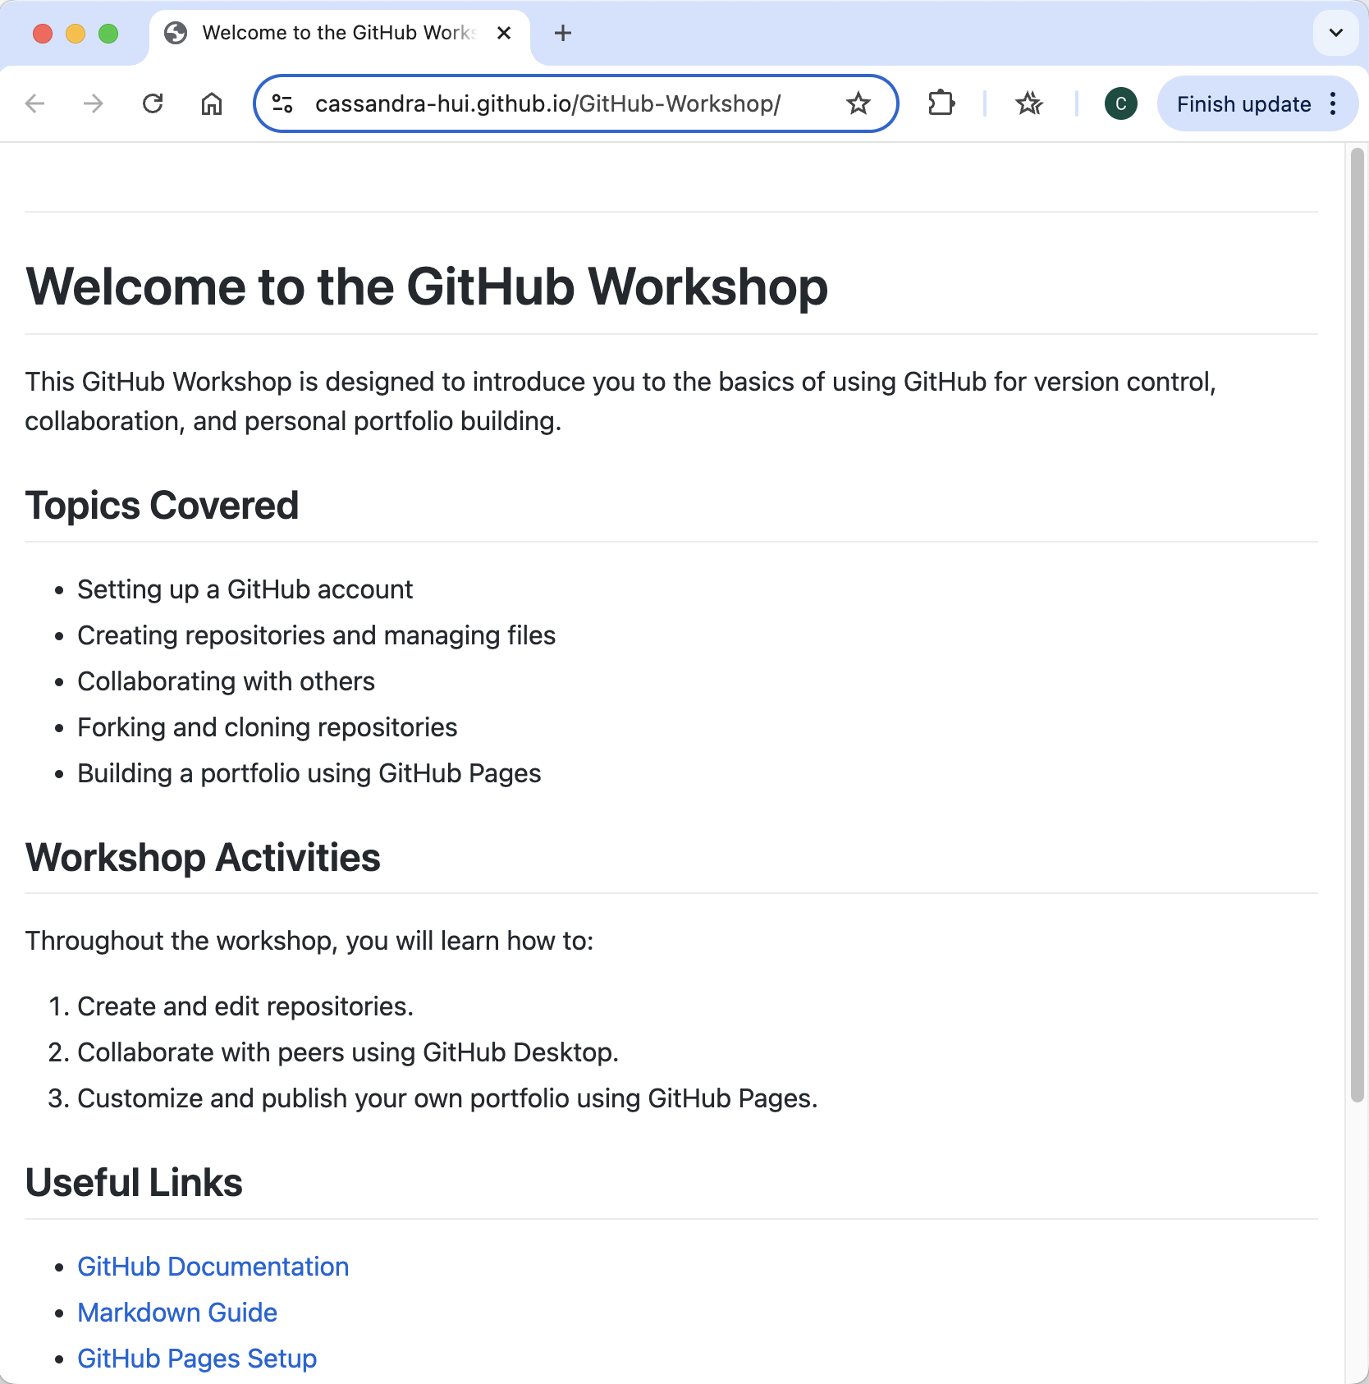
GitHub Pages
What Are GitHub Pages? GitHub Pages is a feature that allows you to host static websites directly from your GitHub repository. It’s often used for personal portfolios, project documentation, or blogs.
How to Enable GitHub Pages: Go to the repository’s Settings > Pages, select the branch and folder (e.g., main and /root), and click Save. Your site will be live at https://username.github.io/repository-name.
What Can You Publish? Websites created with Markdown or HTML, CSS, and JavaScript files. The starting page will be index.md or index.html.

Slide 69
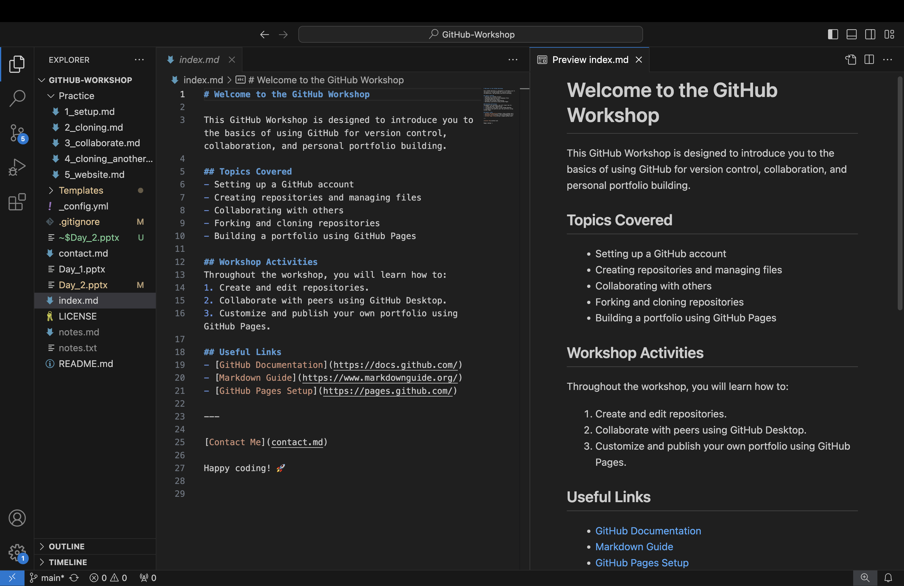
Markdown
You can make a complete GitHub Pages Site with Markdown

Slide 70
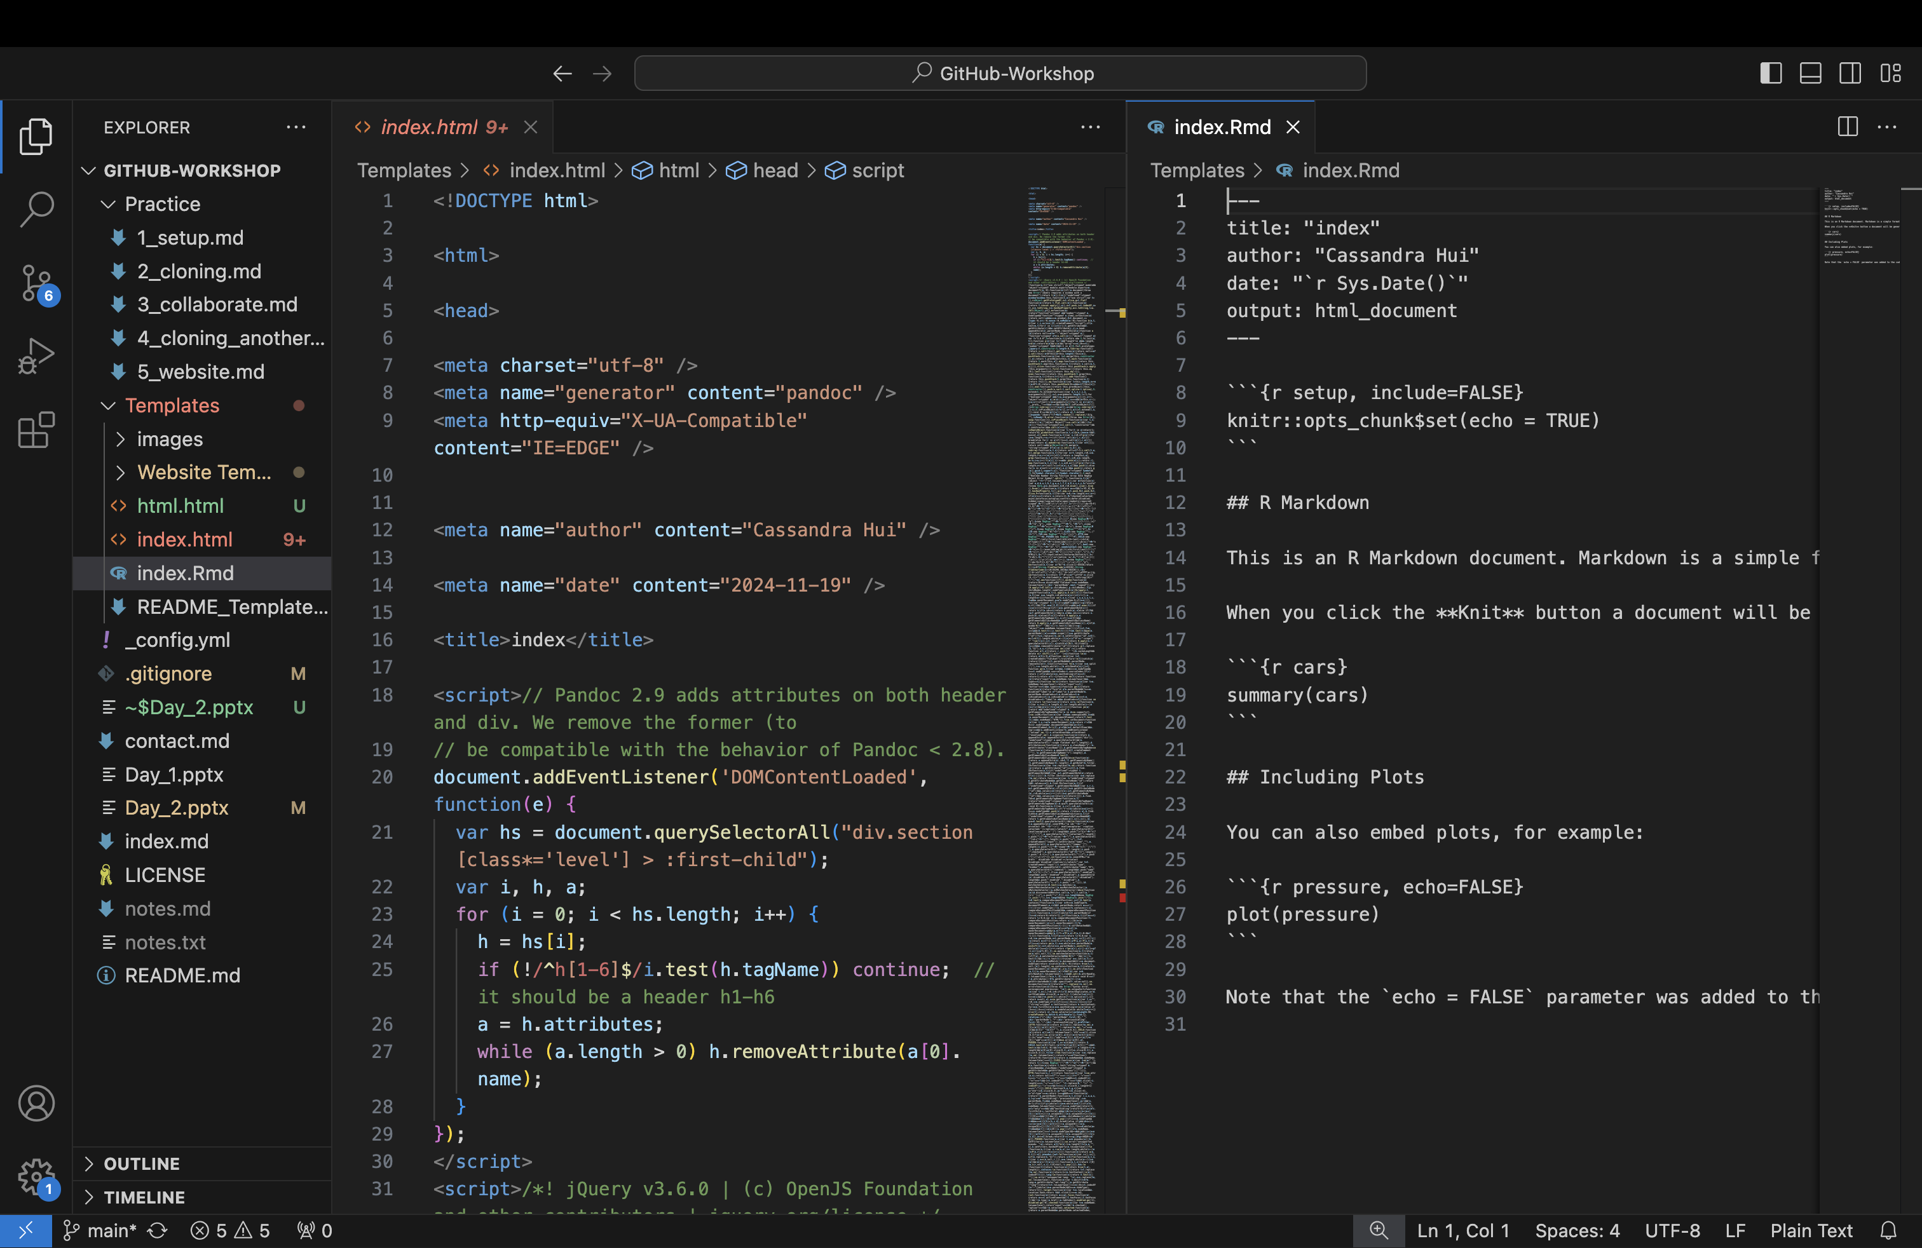
You can make GitHub Pages with HTML—For Example, by rendering an R markdown file.

Slide 71
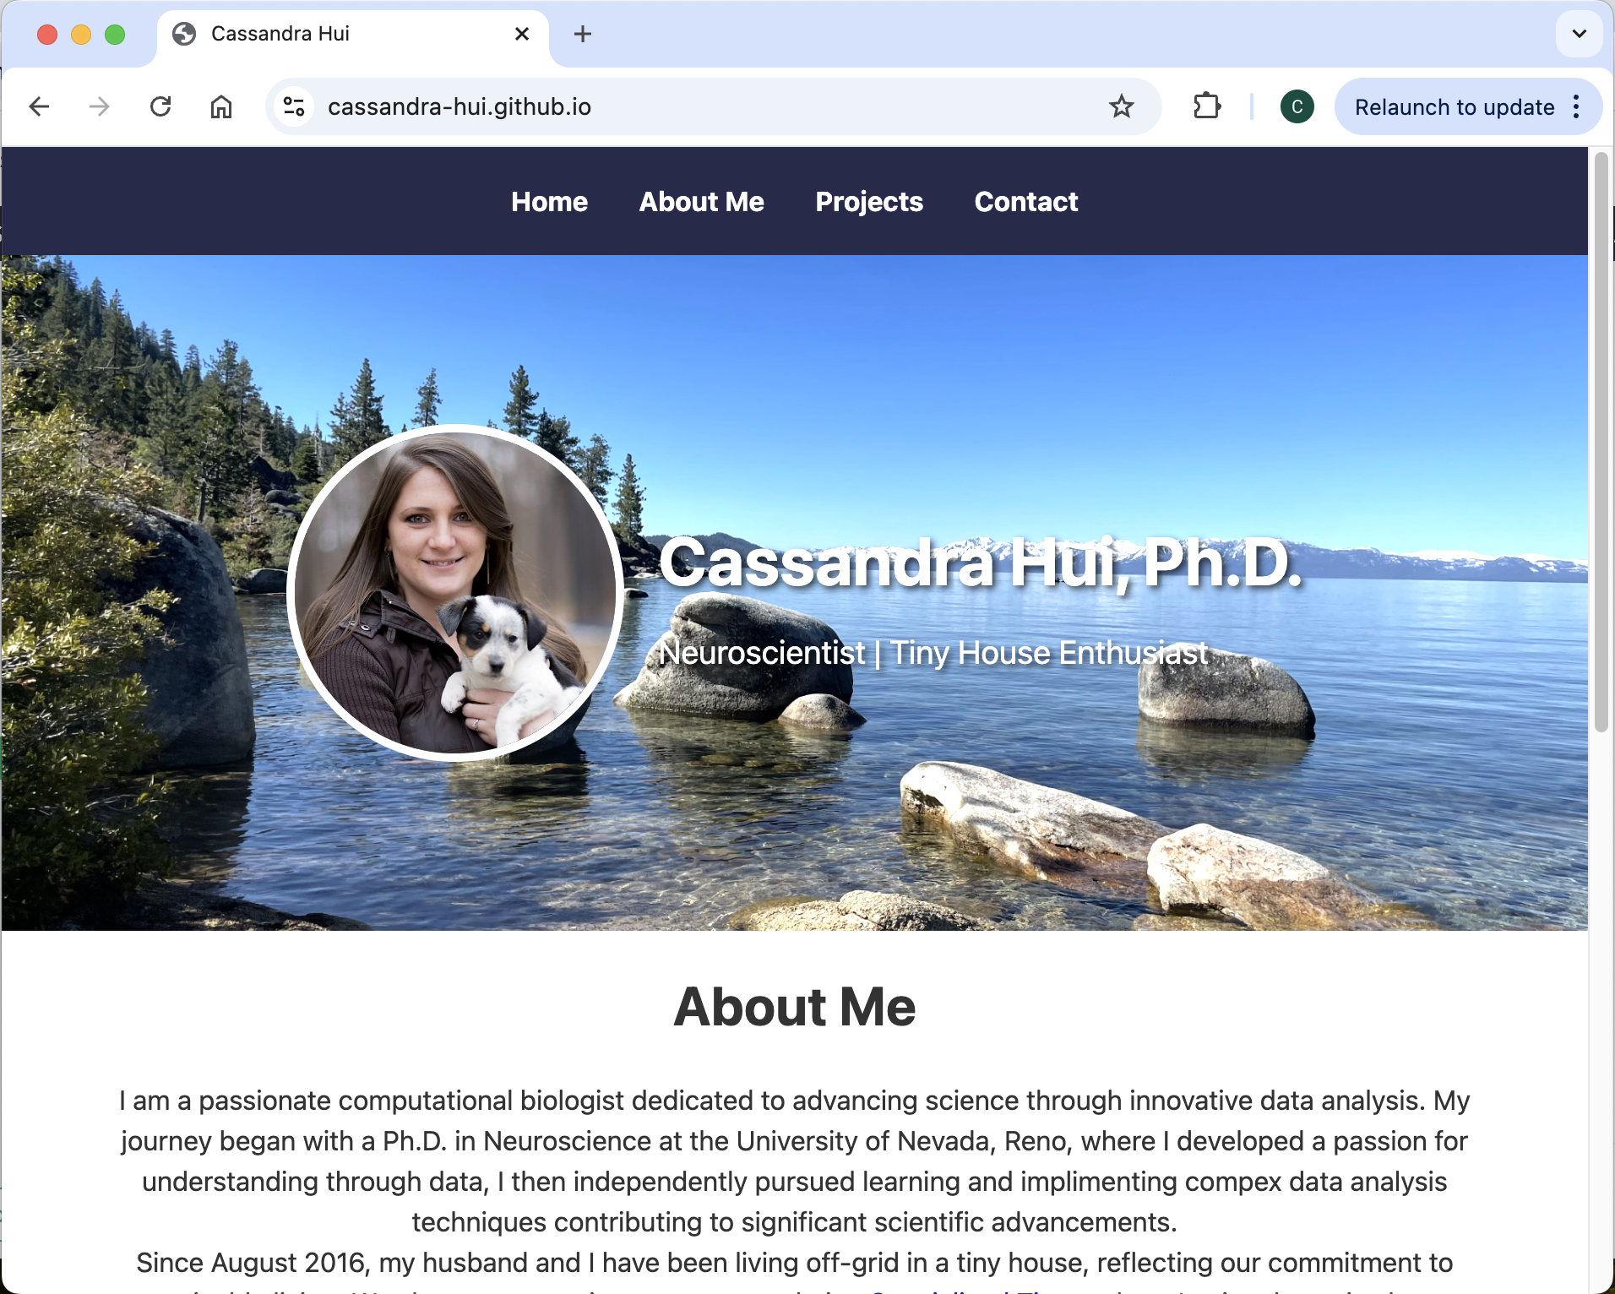
GitHub Website
What is a Personal Website on GitHub Pages?
A username.github.io repository hosts your personal website, which becomes accessible at https://username.github.io. It’s ideal for portfolios, resumes, or blogs.
How to Set It Up:
Create a new repository named username.github.io.
Add HTML, CSS, or Markdown files to design your website.
The site will automatically be published at https://username.github.io.

Slide 72
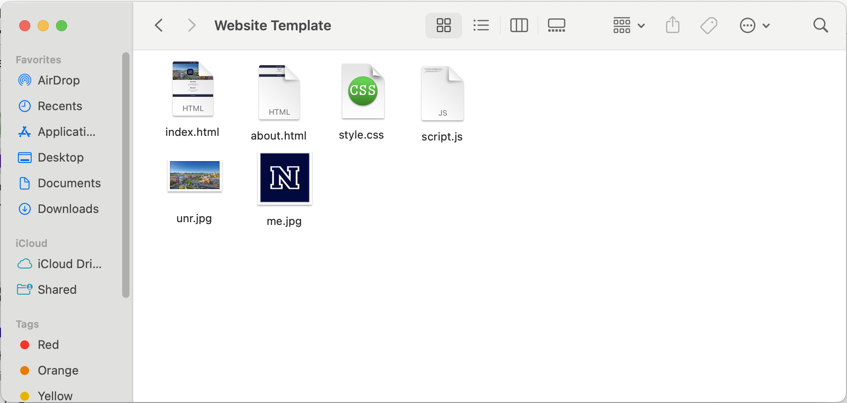
Template Files
I have provided some template files for you to edit to create your own website. Let’s go through the files.

Slide 73
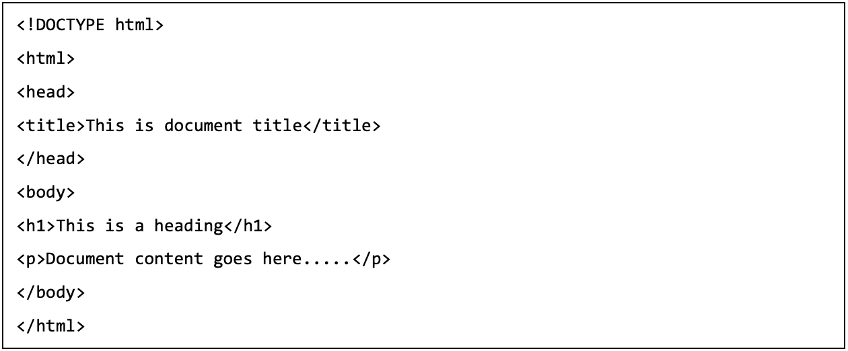
HTML files
Hypertext Markup Language (HTML) is a computer language that's used to structure and define the content of a web page.

Slide 74
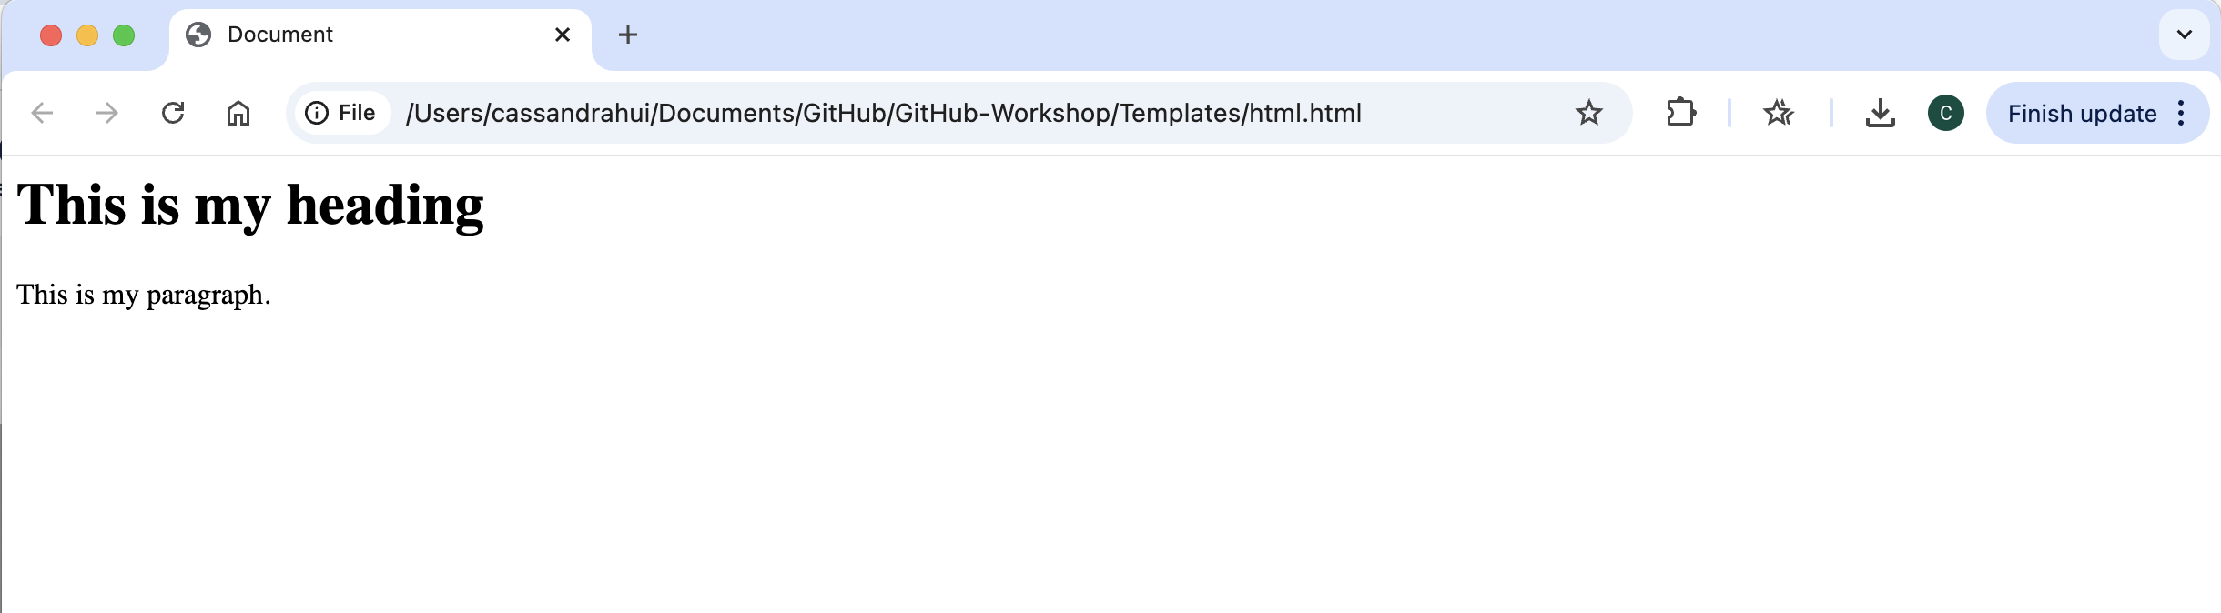

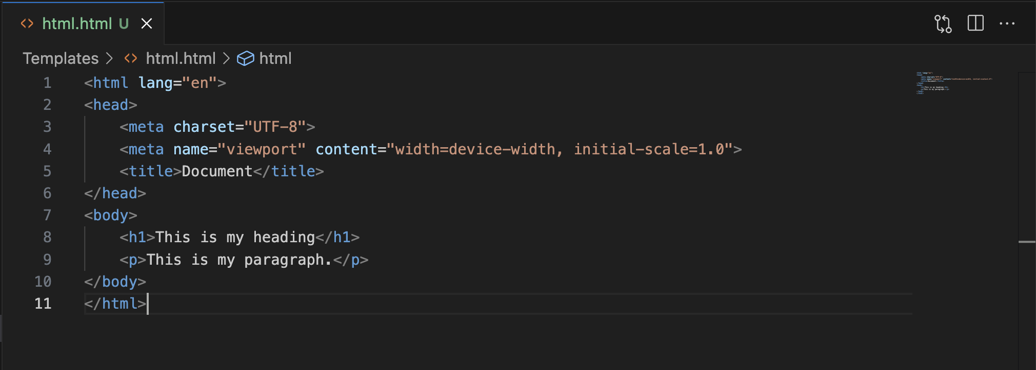

Slide 75
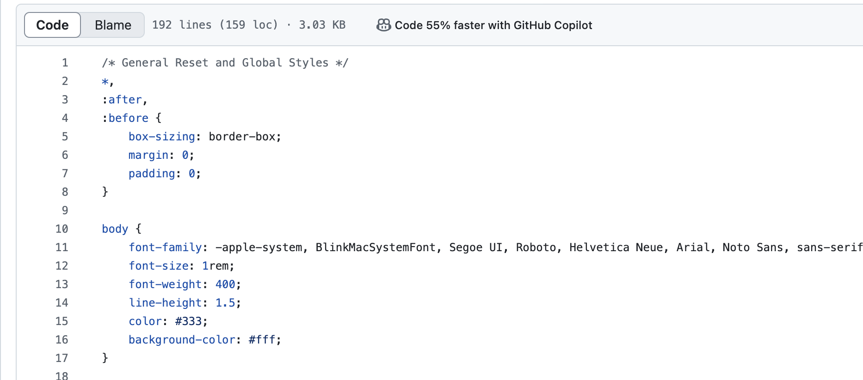
css
Cascading Style Sheets (CSS) is a style sheet language used for specifying the presentation and styling of a document written in a markup language such as HTML

Slide 76
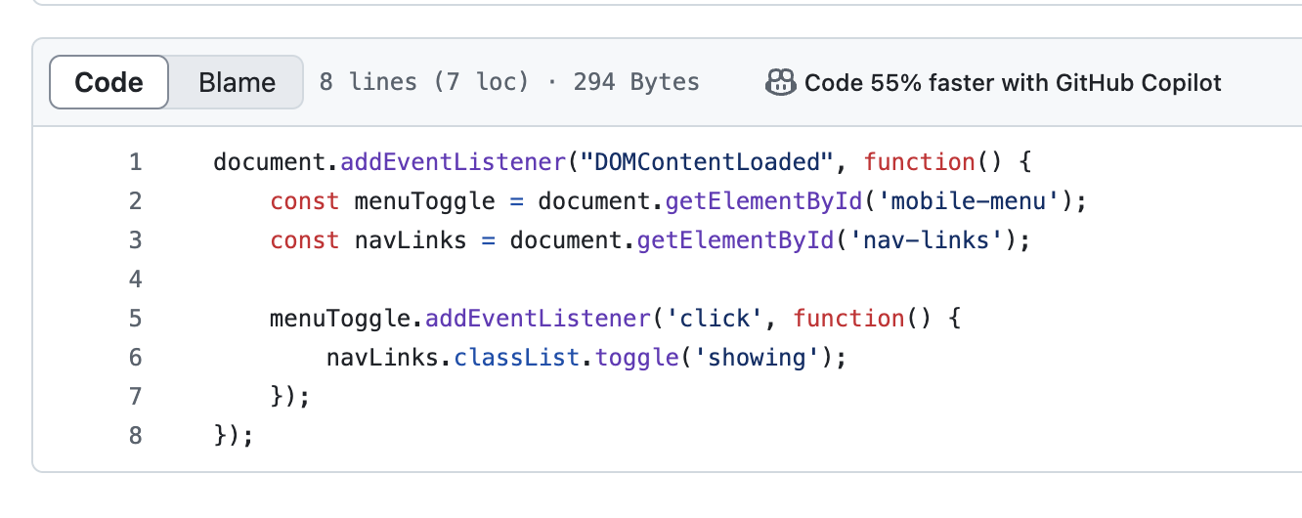


Script.js
JS (JavaScript) are files that contain JavaScript code for execution on web pages.
In this case we only have one code that causes the menu to fold into a “hamburger” style on a mobile device.

Slide 77


Templates
Look up templates for your websites
https://bulma.io/

Slide 78
GitHub Pages
Follow the 6_website.md file in the Practice folder
Clone my repository
Copy and edit website template files
Publish your GitHub Pages website

Slide 79
Create a GitHub Page

Slide 80
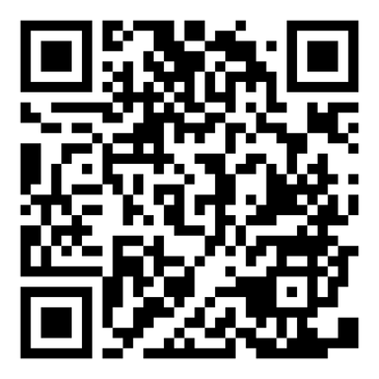
Survey

Slide 81
THANK YOU
References:
https://docs.github.com/en
https://git-scm.com/book/en/v2

